Slide 1
Long-Term Resource Forecasting for Solar & Wind

Slide 2
Problem statement
GHI forecast for 1-year ahead horizon
Wind Speed forecast for 1-year ahead horizon
GHI forecast for 25-year ahead horizon

Slide 3

Sr. No​ | Today's Agenda
1 | Long Term Forecasting
2 | Bias Correction Technique
3 | Data Transformation Technique
4 | Modeling approach for Long term forecasting

Slide 4
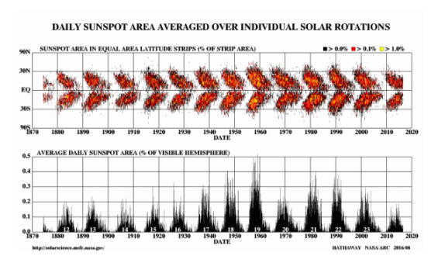
Introduction to Long Term Forecasting
Long term forecasting is quite complex method, as different scenarios related to Climate such as Global Warming, temperature rise due to same, CO2 emission, etc are to be considered to take into account the factors that will affect the generation over a longer range.
Different cyclical phenomenon occurring such as Solar Cycle which is a term used for cyclical pattern of about 11 years that is observed Solar energy which has rising pattern in first 5 years of the cycle and then a decreasing pattern in later 6 years. The Sun's magnetic field goes through a cycle, called the solar cycle. Every 11 years or so, the Sun's magnetic field completely flips.

Slide 5
Actual Data
Solar:
GHI (W/m²):
Resolution: hourly
Duration: 3 year
Natural Features:
Relative Humidity (%)
Temperature (K)
Pressure (Pa)
Wind:
Wind Speed(m/s²) :
Resolution: hourly
Duration: 3 year
Natural Features:
Relative Humidity (%)
Temperature (K)
Pressure (Pa)

Slide 6
Weather Data
Numerical Weather Prediction (NWP) data are the most familiar form of weather model data. NWP computer models process current weather observations to forecast future weather. Output is based on current weather observations, which are assimilated into the model’s framework and used to produce predictions for temperature, precipitation, and hundreds of other meteorological elements from the oceans to the top of the atmosphere.
NCMRWF data:
Temporal Resolution: Hourly data
Variables:
1) Cloud precip
2) Temperature (K)
3) Pressure at mean sea level (HPa)
4) Relative humidity
5) GHI (kWH/m2)
ECMWF data:
Temporal Resolution: 1 day
Variables:
GHI (J/m2)
Temperature (K)
GUST_10m(m/s)

Slide 7
Pipeline
Data Preprocessing
Feature Engineering
Train - Prediction Split
Model Training
Ensembling the forecast of top models
Prediction
Bias Correction for MSEDCL

Slide 8
Bias Correction
What is bias correction?
Both Global and Regional Climate models (GCM, RCM) have systematic errors (biases) in their output. For example climate models often have too many rainy days and tend to underestimate rainfall extremes. There can be errors in the timing of the monsoon or the amount of seasonal rainfall, or temperatures can be consistently too high or too low.
Errors in climate models can be caused by a range of factors. Errors or biases are due to limited spatial resolution (large grid sizes), simplified thermodynamic processes and physics or incomplete understanding of the global climate system. Thus, the use of uncorrected outputs in impact models or climate impact assessments can often give unrealistic results.
To correct these type of biases we develop certain algorithm which are termed as Bias correction techniques.
NOTE: Bias correction is also referred to as bias adjustment. The use of the term correction can be misleading because no method is available which corrects for all the biases.

Slide 9
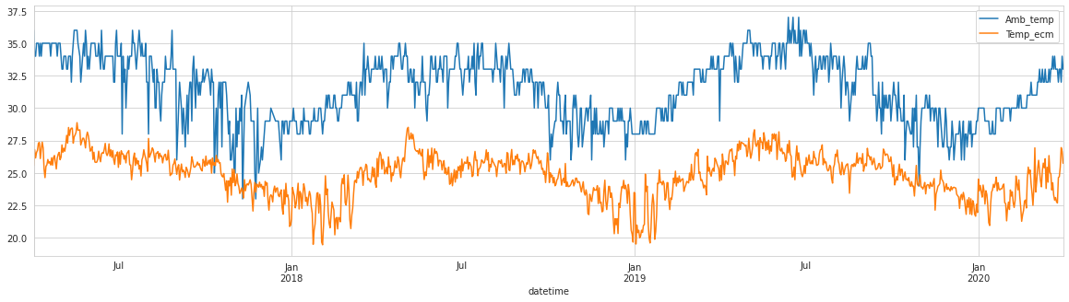
Delta Change Method
⁠Delta = -
⁠
1) The magnitude of difference (delta) between Actual data and GCM/RCM generated data is calculated.
2) Delta is added or subtracted.
3) This method does not take into account the climatic variability such as rainfall or temperature extremes.

Slide 10
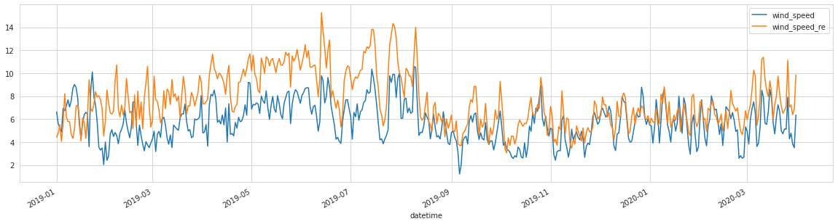
Linear Regression Model
= a + b
1) Linear model is developed using Actual data and Historical RCM/GCM forecasts of same duration.
2) Regression parameters are used to generate bias adjusted future time series.
3) The regression can be made as simple or complex as needed based on the available data and relation between observed climate and climate model output.

Slide 11
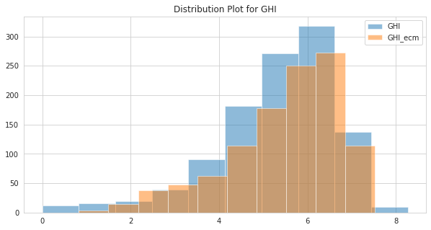
Quantile Mapping
1) The QM methods implement statistical transformations for post-processing of climate modeling outputs.
2) Transforming the distribution functions of the modeled variables into the observed ones using a mathematical function.
3) Relationship between distribution parameter of both the variable is analysed.

Slide 12
Mathematical Concept
1)
Above expression depicts the method used in quantile mapping, where;
= observed variable;
= modeled variable;
= transformation function.
2)
where;
= CDF of ⁠;
= inverse form of the CDF of ⁠,
which is technically referred to as the quantile function.

Slide 13
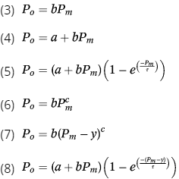
Parametric transformation functions (PTF)
in which and = probability of the observed and modeled variables, respectively; a, b, c, y, and = method-related parameters that are subject to calibration.
Above mentioned equations are different forms of PFT depending upon the relationship between probability distribution functions of the two variables.

Slide 14

Data Transformation Techniques
Normality is an important assumption for many statistical techniques as well as ML algorithm. It is not mandatory but helps in improving the efficiency;
Box-Cox Transformation:
A Box Cox transformation is a transformation of non-normal dependent variables into a normal shape. It does not necessarily transform the data distribution to Normal distribution.
The transformation of Y has the form:
Extended skewness can result into some abnormal forecasted values and thus can affect model accuracy;
2) Logarithmic Transformation:
The log transformation reduces or removes the skewness of our original data. The important caveat here is that the original data has to follow or approximately follow a log-normal distribution.

Slide 15
Experimental Results
Before Data Transformation
Category | Plant Name | State | FY 2020 - 21 | Final Forecast
 |  |  | Actual Value | Value | Accuracy
Solar- GHI-Aggregated | Plant A | Tamil Nadu | 1882.00 | 1999.908 | 93.73%
Wind-Wind Speed Average | Wind Plant A | Gujarat | 5.92 | 5.614 | 94.83%
After Data Transformation
Category | Plant Name | State | FY 2020 - 21 | Final Forecast
 |  |  | Actual Value | Value | Accuracy
Solar- GHI-Aggregated | Plant A | Tamil Nadu | 1882.00 | 1967 | 95.7%
Wind-Wind Speed Average | Wind Plant A | Gujarat | 5.92 | 5.94 | 99.6%

Slide 16
Modelling Approach for Long Term Forecasting
Total Models Evaluated: 26
Models Used: Cat Boost Regressor, Histogram-Based Gradient Boosting, Extreme Gradient Boosting, Light Gradient Boosting, Support Vector Regressor, Extra Trees Regressor, Random Forest Regressor, Linear Tree, Artificial Neural Networks, AR, ARIMA, ARMA, etc
Approach 3:
Section Wise Modeling:
Section 1: January – May (increasing trend)
Section 2: June – September (decreasing trend)
Section 3: October – December (no trend)
Approach 4:
Multivariate Modeling:
1) Target Variable
2) Datetime (Month, day, week)
3) Lag based Features
4) Weather Data
Approach 1:
Univariate Forecasting:
1) Target Variable
2) Datetime (Month, day, week)
3) Lag based Features
Approach 2:
Statistical Modeling:
Target Variable
Lag Based Features Used
Approach 5:
Data Transformation + Multivariate Modeling:
Approach 4 + Data Transformation Techniques on target variable

Slide 17
Train-Test Split, and Validation Metric
​Plants | Training Start​ | Training End​ | Testing Start​ | Testing End​
Solar Plant A | 01-04-2017​ | 31-03-2019 | 01-04-2019 | 31-03-2020
Solar Plant B | 04-01-2018​
Wind Plant A | 01-01-2019​ | 31-12-2019 | 01-01-2020
Wind Plant B
Division | Training Start | Training End | Testing Start | Testing End
Section 1 | 01-01-2018 | 31-05-2018 | 01-01-2019 | 31-05-2019
Section 2 | 01-06-2018 | 30-09-2018 | 01-06-2019 | 30-09-2019
Section 3 | 01-10-2018 | 31-12-2018 | 01-10-2019 | 31-12-2019
Validation Metric:
(1 - (|Forecast – Actual| / Forecast) ) * 100

Slide 18
Results for Long Term Forecasting
Solar
Approach | Average Accuracy
Statistical | 88.280
Section Wise | 94.176
Univariate | 95.709
Multivariate | 94.454
Multivariate + Data Transformation | 96.505
Wind
Approach | Average Accuracy
Statistical | 87.709
Section Wise | 93.543
Univariate | 93.283
Multivariate | 95.040
Multivariate + Data Transformation | 97.115

Slide 19
Thank You !

